Slide 1
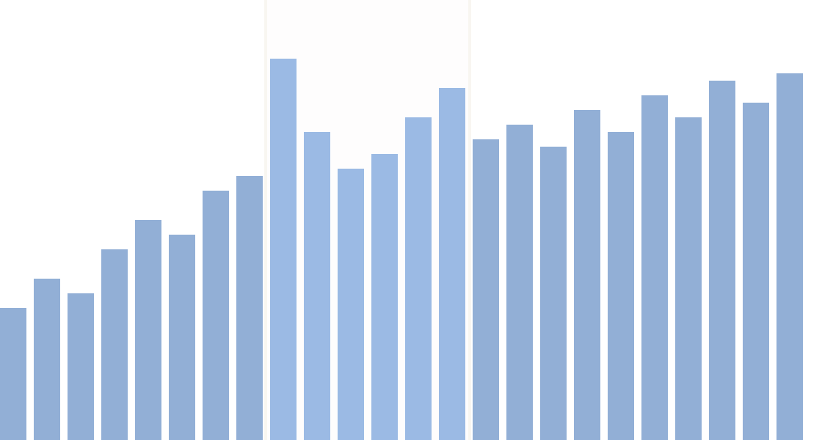
Fast interactive charts
for big data
CSE 578 · DATA VISUALIZATION · NEW TOOLS
How Mosaic, DuckDB and Embedding Atlas work, shown on real-shaped e-commerce data
Sherzod · October 2026
Notes:
This talk is about a group of new tools that keep interactive charts fast even when the data has millions of rows. I'll start with the basic ideas, so you don't need any background: what a dashboard is, what "brushing" means, and what it means to summarize data. Then I'll show why big data makes charts slow, how these new tools fix that, and two demos on the Olist e-commerce dataset from my course project.

Slide 2
What we'll cover
PLAN
1
The basics
Dashboards, brushing and summarizing data. No background needed.
2
The problem
Why big data makes interactive charts slow, and why slow charts matter.
3
The idea
How Mosaic and DuckDB keep charts fast, in three steps.
4
Two demos
An order dashboard, and a map of what customers wrote in reviews.
5
Wrap-up
Power BI, Altair and others compared; when to use what; a glossary.
Fast interactive charts for big data · CSE 578
02
Notes:
Five parts. First the basic vocabulary, because the rest builds on it. Then the problem: what goes wrong when data gets big, and why that's a visualization problem, not just a speed problem. Then the idea behind the new tools, in three steps. Then two demos. And at the end there's a glossary slide with every term from today, which you can use as a cheat sheet.

Slide 3
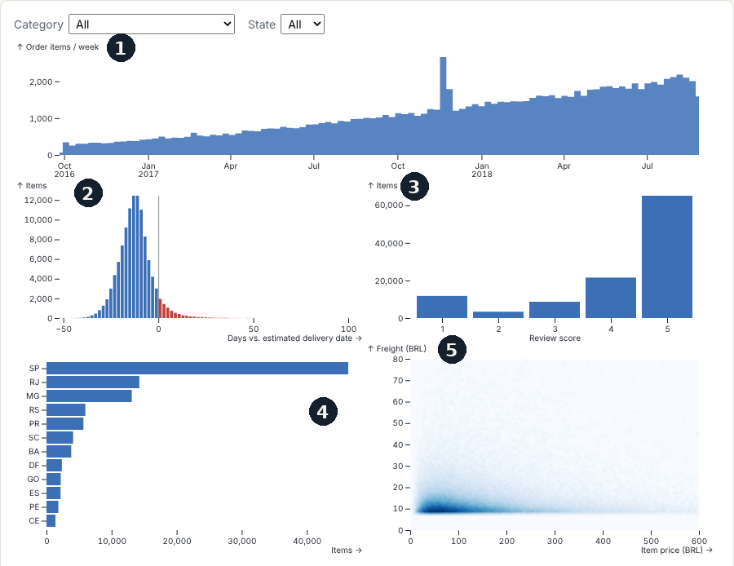
A dashboard: five views of one dataset
THE BASICS · 1 OF 3
1
Timeline
Items ordered per week, 2016–2018. The spike is Black Friday 2017.
2
Histogram
How many days early (blue) or late (red) each delivery arrived.
3
Bar chart
Items per customer review score, 1 to 5 stars.
4
Bar chart
Items per Brazilian state. SP is São Paulo.
5
Density plot
Item price against shipping cost. Darker blue means more items.
Fast interactive charts for big data · CSE 578
03
Notes:
A dashboard is simply several charts of the same data on one screen, each answering a different question. This one shows 110 thousand order items from Olist, a Brazilian online marketplace. Chart 1 is a timeline: how many items were ordered each week; the tall spike is Black Friday 2017. Chart 2 is a histogram: it groups deliveries by how many days early or late they arrived compared to the promised date. Blue bars are early or on time, red bars are late. Chart 3 counts items per review score. Chart 4 counts items per state. Chart 5 is a density plot: every item is a point at its price and shipping cost, and where many points pile up, the color gets darker.

Slide 4
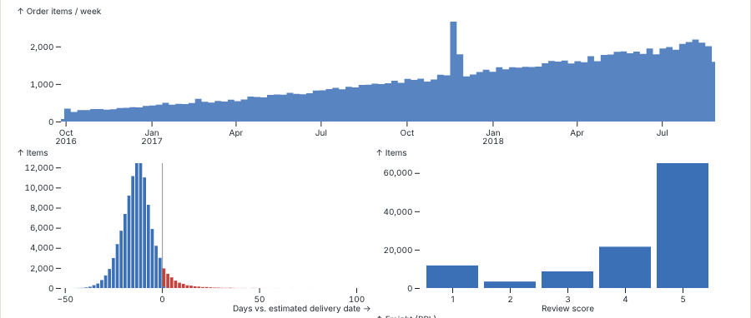
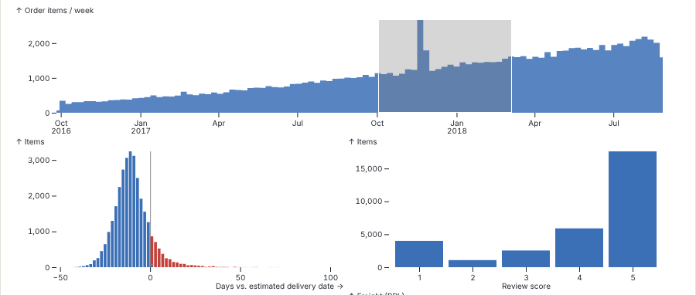
Select in one chart, the others follow
THE BASICS · 2 OF 3
Before: all orders
After: drag across Nov 2017 – Mar 2018
Every chart counts all 110,464 items.
The other charts count only those months: see the smaller y-axes.
Brushing: selecting part of a chart by dragging the mouse across it.
Linking: every other chart updates to show only the selected data.
Fast interactive charts for big data · CSE 578
04
Notes:
The most useful thing about a dashboard is that the charts are connected. On the left, every chart counts all orders. On the right, I dragged across November 2017 to March 2018 on the timeline; that grey area is called a brush. The moment I did that, the histogram and the score chart re-counted using only orders from those months. You can see it in the y-axes: the score chart went from about 60 thousand to 15 thousand. Two terms for this: brushing is the selecting, linking is the other charts following along. Together they let you ask "what was different about this period?" just by dragging.

Slide 5

A chart is a summary of many rows
THE BASICS · 3 OF 3
Raw data: one row per item
Count per star rating
One bar per number
Order | State | Stars
o0 | SP | 5
o1 | PR | 4
o2 | PR | 5
o3 | RJ | 5
o4 | SP | 4
o5 | MG | 3
Stars | Items
1 | 11,783
2 | 3,396
3 | 8,676
4 | 21,521
5 | 65,088
65.1k
21.5k
11.8k
8.7k
3.4k
1★
2★
3★
4★
5★
… and 110,458 more rows
Aggregation: summarizing many rows into a few numbers, such as a count per group.
Fast interactive charts for big data · CSE 578
05
Notes:
One more basic idea, and it's the key to the whole talk. A chart almost never draws your raw rows. On the left is the raw data: one row per item ordered, 110 thousand of them. To draw the review-score chart, we first count how many items have each star rating. That gives just five numbers, in the middle. The chart then draws one bar per number. This step, turning many rows into a few numbers, is called aggregation. Notice the chart only needs those five numbers, never the 110 thousand rows. Remember that, because it's exactly what the new tools take advantage of.

Slide 6

The usual way breaks with big data
THE PROBLEM
WHERE THE DATA LIVES
Step 1: download every row
YOUR BROWSER
A file on a server
Holds every row
1.1 million order rows: 18 MB, even compressed.
Step 2: recounts every chart from all rows on each mouse move.
Like carrying the whole library home just to count how many books are novels.
This is how most web chart libraries work, such as Plotly, Vega-Lite and D3. Fine for thousands of rows; slow to open and laggy to drag at millions.
Fast interactive charts for big data · CSE 578
06
Notes:
Now the problem. The usual way to make a web dashboard is: download the whole data file into the browser, keep every row in memory, and every time you move the brush, recount every chart from all the rows. That's how most web chart libraries you may have heard of work: Plotly, Vega-Lite, D3. With a few thousand rows that's instant. But the full Olist-style data I generated has 1.1 million rows, which is 18 megabytes even compressed. Downloading that is slow, and recounting a million rows on every mouse movement makes dragging feel laggy. It's like carrying the whole library home just to count how many books are novels.

Slide 7



Why speed is a visualization issue
THE PROBLEM
Slow charts mean less exploring
Samples hide small groups
Too many dots hide patterns
Tools that can't hold all rows chart a random sample. A small group, like one state in one week, may shrink to a few rows.
A million dots overlap into one blob, called overplotting. Counting dots per pixel shows where the data piles up.
Adding half a second of delay made people interact less, cover less of the data and notice fewer things (Liu & Heer, 2014).
Goal: charts that stay fast and still use all of the data.
Fast interactive charts for big data · CSE 578
07
Notes:
You might think speed is just a convenience. Research says it changes what people find. Liu and Heer ran an experiment in 2014: adding just half a second of delay to a visualization tool made people interact less, look at less of the data, and make fewer observations. Second, when a tool can't handle all the rows, people often chart a random sample instead, and small groups, like one state in one week, can shrink to a handful of rows. Third, drawing a million dots doesn't work either: they overlap into one blob, which is called overplotting. Counting dots per pixel, like the density plot we saw, fixes that. So the goal is charts that stay fast and still use all the data.

Slide 8
Meet the three tools
THE IDEA
THE COORDINATOR
THE DATABASE
BUILT ON MOSAIC
Mosaic
DuckDB
Embedding Atlas
University of Washington · 2024
DuckDB Labs · open source
Apple · 2025
Connects charts to a database. Turns every chart and every selection into a question for it.
Built for fast counting and summarizing. Runs on a server, in Python, or inside a web page.
Turns large collections of text into a map you can explore. Demo 2.
Database: software that stores tables of data and answers questions about them.
SQL: the language for asking a database questions; one question is a query.
Fast interactive charts for big data · CSE 578
08
Notes:
Three tools. Mosaic comes from the Interactive Data Lab at the University of Washington, the same group behind Vega-Lite; its paper was published in 2024. Mosaic is the coordinator: it connects charts to a database. DuckDB is the database: a free, open-source engine designed for counting and summarizing large tables quickly, and it's small enough to run on a server, in Python, or even inside a web page. Embedding Atlas is a tool Apple released in 2025 for exploring large collections of text; it's built on top of Mosaic, and it's our second demo. Two terms: a database stores tables and answers questions about them, and SQL is the language for those questions. One question is called a query.

Slide 9
Charts ask, the database answers
THE IDEA
Timeline
COORDINATOR
DATABASE
"Items per week?"
Mosaic
DuckDB
Collects each chart's question
Adds your selection as a filter
Sends the questions as SQL
Reuses answers it already has
questions
Histogram
Holds all the rows
Does the counting
Sends back only the counts
Can sit on a server or in the browser tab
"Items per day of delay?"
Score bars
"Items per star rating?"
just the counts
Density plot
"Items per pixel?"
Like asking the librarian “How many novels do you have?” instead of carrying the library home.
Fast interactive charts for big data · CSE 578
09
Notes:
Here's the core idea in one picture. Each chart on the left doesn't hold any rows. Instead it has a question: the timeline asks "how many items per week?", the score chart asks "how many items per star rating?", and so on. Mosaic, in the middle, collects these questions, adds whatever you've selected as a filter, and sends them to the database in SQL. DuckDB, on the right, holds all the rows, does the counting, and sends back only the counts. The database can sit on a server, so nothing big is downloaded, or inside the browser tab, where the file is loaded once into a database built for counting. It's like asking the librarian how many novels they have, instead of carrying the whole library home to count them yourself.

Slide 10
Each chart is one question
THE IDEA · STEP 1 OF 3
In plain words
In SQL, simplified
The answer
How many items got each star rating?
SELECT stars, count(*)
FROM orders
GROUP BY stars
Stars | Items
1 | 11,783
2 | 3,396
3 | 8,676
4 | 21,521
5 | 65,088
The answer is 5 numbers, whether the table has 100 thousand rows or 100 million.
Fast interactive charts for big data · CSE 578
10
Notes:
Step one. Every chart is turned into one question for the database. For the score chart, the question in plain words is: how many items got each star rating? In SQL it looks like the middle box: select the star rating and a count, from the orders table, grouped by star rating. You don't write this yourself; Mosaic writes it from the chart description. The database sends back five numbers, and that's all the chart needs to draw five bars. The important point: the answer is five numbers whether the table has a hundred thousand rows or a hundred million.

Slide 11
A selection becomes a filter
THE IDEA · STEP 2 OF 3
1
2
3
You drag on the timeline
Mosaic writes a filter
The other charts ask again
You select Nov 2017 to Mar 2018.
WHERE week BETWEEN
'2017-11' AND '2018-03'
Each one re-asks its own question with the filter added, then redraws.
Crossfilter: each chart is filtered by the other charts' selections but not by its own, so the chart you drag on keeps showing everything.
Fast interactive charts for big data · CSE 578
11
Notes:
Step two: what happens when you brush. You drag on the timeline from November 2017 to March 2018. Mosaic turns that into a filter, the WHERE part of a SQL question: only rows whose week is between those dates. Then every other chart asks its own question again with that filter added, and redraws with the new answer. One detail with a name: crossfilter. Each chart is filtered by the other charts' selections, but not by its own. Otherwise the timeline would shrink down to just the months you selected, and you couldn't see or move your selection.

Slide 12
Prepare summaries in advance
THE IDEA · STEP 3 OF 3
1
When you start dragging
Time per update in the demo
Mosaic builds small summary tables: for each chart, the counts for every possible position of your selection.
Recount all rows: 120–200 ms
2
While you keep dragging
Read the summary: 2–37 ms
Each mouse move just reads those small tables instead of recounting every row.
110k rows, measured in a headless browser
Pre-aggregation: computing summary tables ahead of time so later questions are fast.
Like a shop that keeps daily sales totals, so it never re-adds every receipt to answer “How much did we sell in March?”
Fast interactive charts for big data · CSE 578
12
Notes:
Step three is the clever part. While you drag, the selection moves one pixel at a time, so there are only a limited number of positions it can be in. When you start dragging, Mosaic quietly builds small summary tables: for each chart, the counts for every possible position of your selection. Then each mouse movement just reads from those small tables instead of recounting every row. In my test, recounting all rows took 120 to 200 milliseconds per update; reading the summary took 2 to 37 milliseconds. This trick is called pre-aggregation. It's like a shop that keeps daily sales totals, so it never has to re-add every receipt to answer "how much did we sell in March?"

Slide 13
Charts receive numbers, not rows
THE IDEA · RESULT
110,464
≈87 KB
5
rows stay in the database
of answers drew the whole first screen, about 20 questions
numbers for the star chart, at any data size
A chart never needs more numbers than it has pixels, so the work grows with the chart's size, not the data's size.
Fast interactive charts for big data · CSE 578
13
Notes:
Put the three steps together and here's the result from my test. 110 thousand rows sit in the database. To draw the whole first screen of five charts, Mosaic asked about 20 questions, and all the answers together were about 87 kilobytes. The star chart got five numbers, and would get five numbers at any data size. The general rule: a chart never needs more numbers than it has pixels on screen. So the work depends on how big the chart is, not on how big the data is. That's why these tools can go to millions of rows.

Slide 14
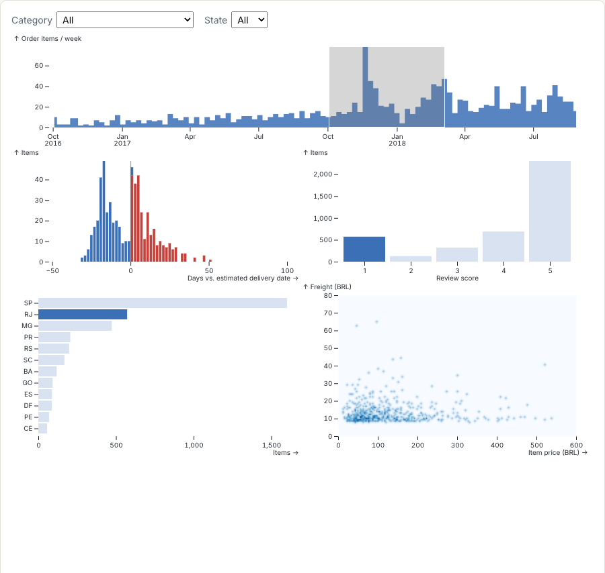
Do late deliveries get bad reviews?
DEMO 1 · OLIST ORDERS
I SELECTED
Nov 2017 – Mar 2018 on the timeline, the 1★ bar, and the state RJ (Rio de Janeiro).
WHAT CHANGED
The histogram now has many red bars right of zero. About half of these 580 items arrived late, against 7% of all items.
WHAT IT SUGGESTS
Late delivery and 1-star reviews go together.
Synthetic data in the real Olist format, with this link built in. Next step: rerun on the real Kaggle data.
Fast interactive charts for big data · CSE 578
14
Notes:
Now the first demo; I'll run it live if the network allows, otherwise this screenshot. The question: do late deliveries get bad reviews? I dragged across November 2017 to March 2018, clicked the one-star bar and clicked Rio de Janeiro. Look at the histogram: remember, red bars are late deliveries. With these selections, about half of the 580 matching items arrived late, compared with 7 percent of all items. So late delivery and one-star reviews go together. One honest caveat: this is synthetic data in the exact Olist format, and my generator builds that link in on purpose, so the real test is running the same dashboard on the real Kaggle data. The point today is how quickly the dashboard lets you ask the question.

Slide 15

Turning text into a map
DEMO 2 · BEFORE WE START
1 · A REVIEW
2 · A LIST OF NUMBERS
3 · A DOT ON A MAP
“Entrega atrasada, ninguém responde”
[0.12, −0.80, 0.33, …]
64 numbers per review. Similar texts get similar numbers.
“Late delivery, nobody answers”
UMAP squeezes the 64 numbers into 2: x and y.
Embedding: a list of numbers that describes a text, so that similar texts get similar numbers.
On the map, “late delivery” sits next to “product didn't arrive”, and far from “excellent product”.
Fast interactive charts for big data · CSE 578
15
Notes:
The second demo uses review text, so one new idea first. How do you put text on a chart? Step 1: take a review, like "Entrega atrasada, ninguém responde", which is Portuguese for "late delivery, nobody answers". Step 2: turn it into a list of numbers, called an embedding, built so that similar texts get similar numbers. In my demo it's 64 numbers per review, based on which letter combinations appear; modern AI models do the same thing and capture meaning even better. Step 3: a method called UMAP squeezes those 64 numbers down to two, an x and a y, while keeping similar reviews close together. Now every review is a dot on a map, and "late delivery" ends up next to "product didn't arrive", far away from "excellent product".

Slide 16
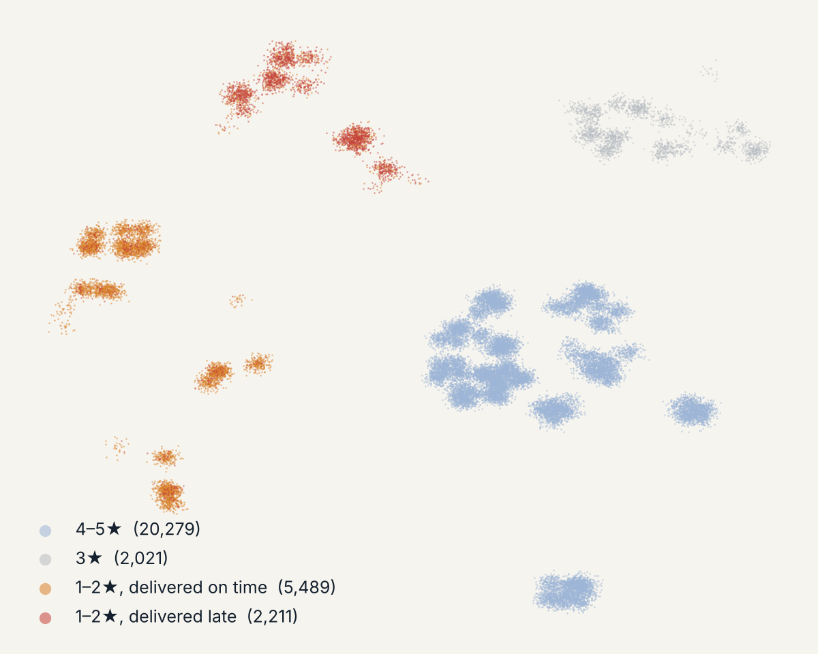
A map of 30,000 customer reviews
DEMO 2 · EMBEDDING ATLAS
HOW TO READ IT
Each dot is one review. Dots close together use similar wording. Color shows the star rating and, for 1–2★, whether the order was late.
WHAT IT SHOWS
Bad reviews form two separate groups: delivery complaints, mostly late orders, and product complaints, mostly on time.
WHY IT MATTERS
Same star rating, two different problems to fix.
Live tool: selecting dots filters the other charts. Needs a WebGPU browser such as recent Chrome.
Fast interactive charts for big data · CSE 578
16
Notes:
Here's the result: 30 thousand reviews, each one a dot. Dots close together are reviews with similar wording. I colored them by star rating, and for the one- and two-star reviews, by whether the order arrived late. The happy reviews sit in one big region on the right. The interesting part is the bad reviews: they don't form one group. The red group is delivery complaints, and those orders were mostly late. The orange group is product complaints, like broken or wrong items, and those orders mostly arrived on time. Same star rating, two completely different problems for the business to fix. This picture is a static copy; in the live Embedding Atlas tool you can select a group of dots and the other charts filter, exactly like the dashboard, because it's built on Mosaic.

Slide 17
How it compares to popular tools
WRAP-UP · COMPARISON
Tool | You build by | Millions of rows? | Linked charts | Cost
Excel | Clicking | No: limit of 1,048,576 rows | Slicers only | Paid, closed
Power BI | Clicking (Windows app) | Yes, but charts sample: a scatter plot shows 3,500 dots by default | Yes, built in | $14/user/month to share, closed
Tableau | Clicking | Yes: extracts or live database queries | Yes, via actions | Paid to share, closed
Plotly / Dash | Python code | All rows go to the browser unless you write server code | Extra code (callbacks) | Free, open source
Altair | Python code | All rows go into the chart; 5,000-row default limit | Yes, built in | Free, open source
Mosaic | Python or JS | Yes: the database counts, charts get only totals | Yes, built in | Free, open source
Sources: Microsoft Power BI docs and pricing; Altair docs (checked Oct 2026)
17
Notes:
How does this compare to tools you may already know? Excel can't hold more than about a million rows in a sheet, and it has slicers but no real brushing. Power BI and Tableau are the big business tools: you build by clicking, they handle large data, and linked charts are built in. But they're closed products and you pay to share. Power BI also thins out big charts: a scatter plot shows at most 3,500 dots by default. Plotly and Altair are free Python libraries, but by default they put every row into the browser; Altair even stops at 5,000 rows unless you change a setting. Mosaic is the only one here that is free, open source, code-based, and has the database do the counting.

Slide 18
So why not Power BI or Altair?
WRAP-UP · COMPARISON
Power BI
Altair
Great for business reports. Its DirectQuery mode even asks a database, like Mosaic.
Great for learning charts in Python. Built on Vega-Lite, from Mosaic's lab.
Closed: you can't see or change how it works
Windows-only app; $14 per user per month to share
Samples big data: 3,500 dots per scatter plot by default
Copies every row into the chart
Stops at 5,000 rows unless you change a setting
VegaFusion add-on: 100,000 rows, or millions inside Jupyter
Pick it when your company already uses Microsoft and needs standard reports.
Pick it when your data has under about 50,000 rows, or the chart is for a report.
Mosaic = Power BI's “ask the database” idea + Altair's free, code-first style.
Sources: Microsoft Power BI docs and pricing; Altair docs (checked Oct 2026)
18
Notes:
The two questions people ask most. Why not Power BI? Honestly, for a normal company dashboard, Power BI is often the right choice, and its DirectQuery mode already uses the same "ask the database" idea. But it's closed, so you can't see or change how it works, which matters in a course about how visualization works. The authoring app is Windows-only, sharing costs 14 dollars per user per month, and big scatter plots are sampled to 3,500 dots by default. Why not Altair? Altair is great for learning, and it's built on Vega-Lite, which comes from the same University of Washington lab as Mosaic. But it copies every row into the chart and stops at 5,000 rows by default. An add-on called VegaFusion raises that to 100,000, or millions inside Jupyter. Mosaic combines the two: Power BI's ask-the-database idea, in Altair's free, code-first style.

Slide 19


When to use these tools
WRAP-UP
Good fit
Think twice
Hundreds of thousands of rows, or more
Several linked charts you explore by brushing
You need all the data, not a sample
Small data, under about 50,000 rows: Plotly or Altair is simpler
The web version needs internet to load its libraries
Young tools (version 0.x): features may change
Only works for calculations a database can do
Fast interactive charts for big data · CSE 578
19
Notes:
So when should you use this? It's a good fit when you have hundreds of thousands of rows or more, several linked charts you want to explore by brushing, and you want to use all the data rather than a sample. Think twice in these cases. If your data is small, under about fifty thousand rows, a simpler library like Plotly or Altair is easier and fast enough. The web version downloads its libraries from the internet, so test before a presentation. These tools are young, still version zero-point-something, so features can change. And everything a chart shows must be something a database can calculate; for example, the review map had to be computed beforehand in Python.

Slide 20
Send the question,
not the data.
TAKEAWAY
Charts ask questions. Selections become filters. Summaries keep every update fast.
Notes:
If you remember one sentence from today: send the question, not the data. Instead of moving millions of rows to the chart, each chart asks the database a question and gets back only the few numbers it needs to draw. Selections become filters on those questions, and summaries prepared in advance keep every update fast. That's how a browser tab can explore millions of rows without slowing down.

Slide 21
Every term from today
WRAP-UP · CHEAT SHEET
Dashboard
Brushing
Linking
Aggregation
Several charts of one dataset on one screen.
Selecting part of a chart by dragging the mouse.
Other charts update to show only the selection.
Summarizing many rows into a few numbers.
Latency
Overplotting
Database
SQL, query
The delay between your action and the update.
So many dots overlap that patterns disappear.
Software that stores tables and answers questions.
The language for database questions; one question.
Crossfilter
Pre-aggregation
Embedding
UMAP
Each chart is filtered by the others' selections.
Summary tables built early so updates are fast.
A list of numbers that describes a text.
Squeezes many numbers into an x, y map position.
Fast interactive charts for big data · CSE 578
21
Notes:
Here's every term from today on one slide, in the order they came up, so you can use it as a cheat sheet. I'll leave it up while I take questions.

Slide 22
Read more, run the code
REFERENCES
J. Heer, D. Moritz. Mosaic: An Architecture for Scalable & Interoperable Data Views. IEEE TVCG 30(1), 2024. idl.uw.edu/mosaic
In the code package
D. Ren, F. Hohman, H. Lin, D. Moritz. Embedding Atlas: Low-Friction, Interactive Embedding Visualization. arXiv:2505.06386, 2025. github.com/apple/embedding-atlas
generate_synthetic_olist.py
Olist-format data at any size
prepare_data.py
Joins the tables with DuckDB
Z. Liu, J. Heer. The Effects of Interactive Latency on Exploratory Visual Analysis. IEEE TVCG (InfoVis), 2014. idl.uw.edu/papers/latency
dashboard.py
The five-chart dashboard (demo 1)
vgplot Python API and the Mosaic Jupyter widget. pypi.org/project/vgplot · idl.uw.edu/mosaic/jupyter
web/index.html
Runs it in a browser, with a SQL log
Olist Brazilian e-commerce dataset. kaggle.com/datasets/olistbr/brazilian-ecommerce
reviews_atlas.py
The review map (demo 2)
Fast interactive charts for big data · CSE 578
22
Notes:
If you want to read further, the Mosaic paper is the place to start; it's readable. The Liu and Heer paper is the latency study I quoted. All the code from today is in the package on the right, and it runs on the real Olist data from Kaggle too. Thank you; happy to take questions.

Slide 23
The dashboard is ~70 lines of Python
APPENDIX · FOR QUESTIONS
DASHBOARD.PY · EXCERPT, SIMPLIFIED
Run it
orders = vg.parquet("orders.parquet")
brush = vg.selection.crossfilter()
vg.plot(
vg.raster(orders, x="price", y="freight_value",
fill="density", filter_by=brush),
vg.interval_xy(bind=brush),
vg.x_domain([0, 600]), vg.y_domain([0, 80]),
)
python generate_synthetic_olist.py
python prepare_data.py
python dashboard.py
cd web && python -m http.server
Or in Jupyter
The same view renders through mosaic-widget, with DuckDB in the Python kernel.
Fast interactive charts for big data · CSE 578
A1
Notes:
The code is short. This excerpt is the density raster: point it at the Parquet file, give it x, y and a density fill, and attach a 2-D interval brush to the shared selection. The full dashboard is about seventy lines including comments. To run it: generate or point at the Olist CSVs, run the DuckDB prep script, export the spec, and serve the web folder. In Jupyter the same view object renders directly, with DuckDB running in the Python kernel instead of the browser.

Slide 24
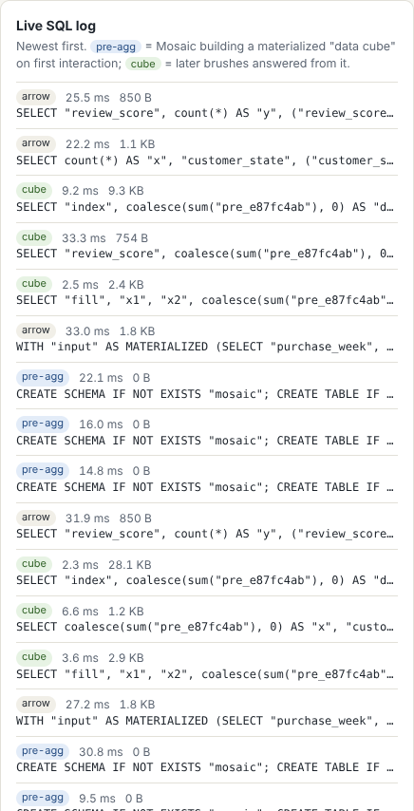
The real SQL behind demo 1
APPENDIX · FOR QUESTIONS
Filters my three selections produced
purchase_week BETWEEN epoch_ms(…) AND epoch_ms(…)
review_score IN (1)
customer_state IN ('RJ')
Tags in the log (right)
Tag | Meaning
arrow | A normal question over all rows (step 1)
pre-agg | Building a summary table on the first drag (step 3)
cube | A fast read from a summary table (step 3)
Fast interactive charts for big data · CSE 578
A2
Notes:
For anyone who wants the details. These are the actual filters Mosaic generated from my three selections: a date range on the purchase week, the one-star score, and the state RJ. On the right is the live SQL log from the demo page. Blue pre-agg tags are summary tables being built on the first drag; green cube tags are the fast reads from them; arrow tags are normal questions over all rows. Each line shows how long the question took and how big the answer was.

